Slide 1

Data cleaning
Minh Nguyen

Slide 2

Practice
Prerequisites:
Install Excel 2016 or the like
Download P-Card files
Open OSU FY2011 P-Card.xlsx

Slide 3
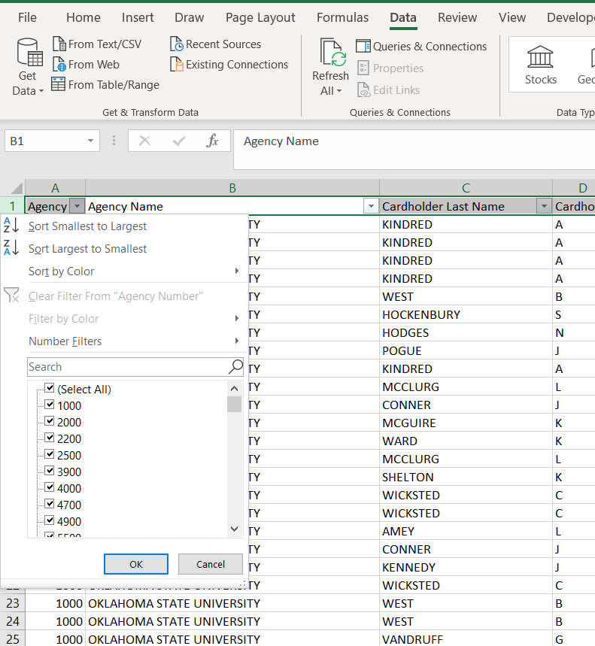
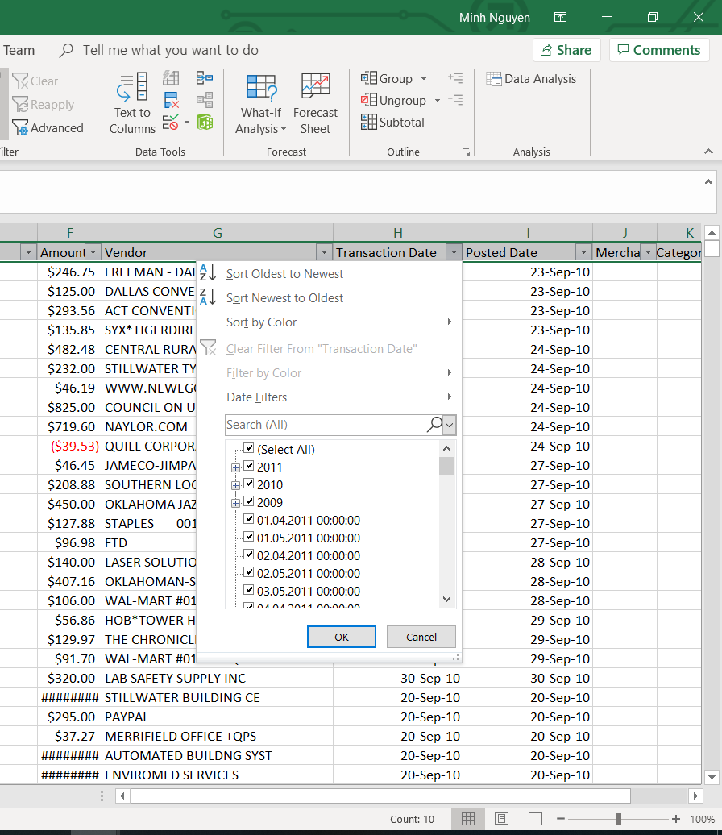
1. Observe and Explore
Use filter and click on each column to observe the consistency of data and get idea of what to clean up
Which columns have in inconsistent data? (Discuss in group)

Slide 4

2. What to clean
Cleaning candidates:
Cardholder Last Name
Cardholder First Initial
Description
Transaction Date
Posted Date
Merchant Category Code (MCC)

Slide 5


3. Prioritize cleaning items
Data cleaning is expensive, time-consuming, and tedious
Choose what to clean based on:
Questions we are trying to answer
Available knowledge
Available resource
Time budget
Using above criteria, rank cleaning candidates (work in group)

Slide 6
Top to bottom (high to low)
Items | Justification
Transaction Date | Support time series analysis; can analyze transactions per month and year; possible to clean
Posted Date | Support time series analysis; can analyze transactions per month and year; possible to clean
Merchant Category Code (MCC) | A lot of categories are closely similar; can be grouped into group => reduce number of categories when analyzing by categories
Cardholder Last Name | Some go by Agent ID. No available knowledge to clean
Cardholder First Initial | Some go by Agent ID. No available knowledge to clean
Description | Some go by transaction date. No available knowledge to clean

Slide 7
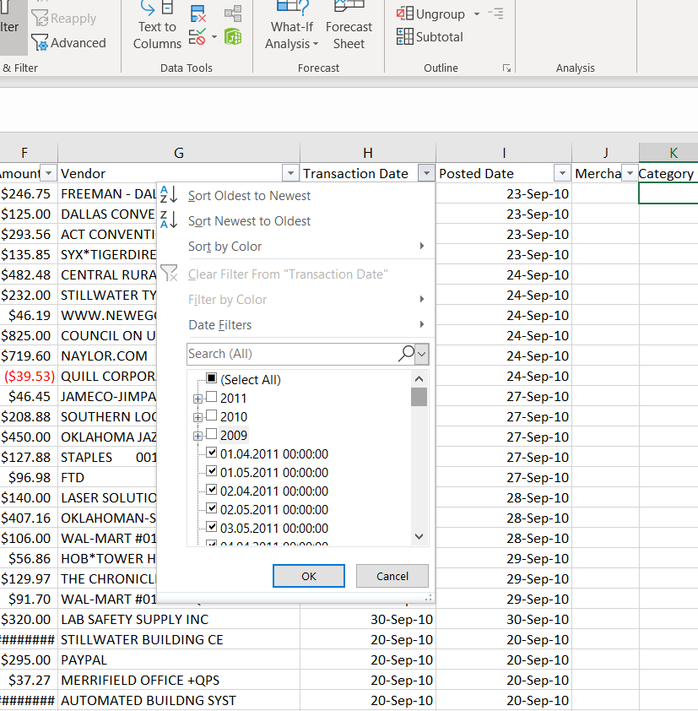
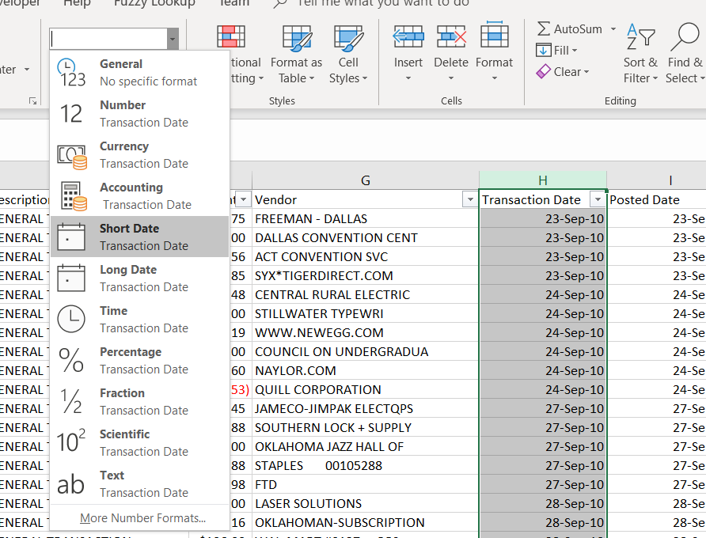
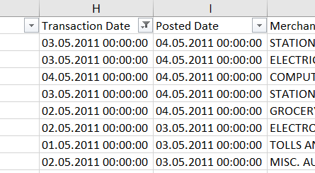
4. Get to work
Select Transaction Date column and select Short Date to attempt reformat date
On filter, uncheck the consistent items to filter just the inconsistent items
To just get the date part, use formula in the blank column (K) and copy it down to all cells in filtered range: =TRIM(LEFT(H289822,FIND(" ",H289822)))
The value we get is as “03.05.2011” and it’s in the form of dd.mm.yyyy, but it’s in text format
Reconstruct date by using formula =DATE(RIGHT(K289822,4),MID(K289822,4,2),LEFT(K289822,2)) in another blank column. Copy the formula down to all cells in filtered range

Slide 8
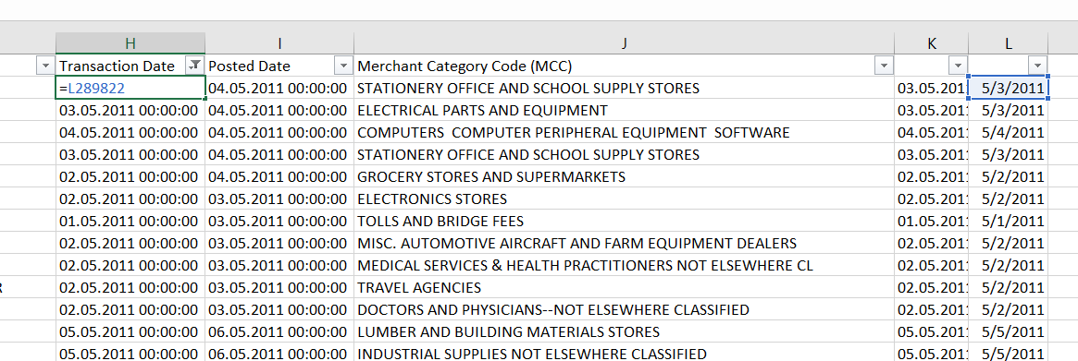
4. Get to work
Unfilter and select the columns with formula
Copy and paste values to remove the formulas
Filter again by inconsistent data
In inconsistent cell, refer to the corrected cell an copy the formula down to the rest of cells in filtered range

Slide 9

Try cleaning Posted Date column
Hints: Trim(), Left(), Right(), Mid(), Find(), Date()

Slide 10
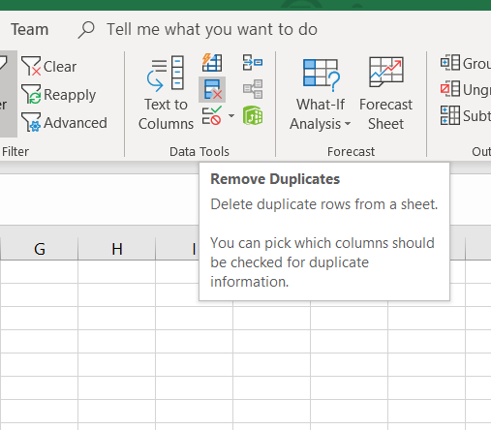
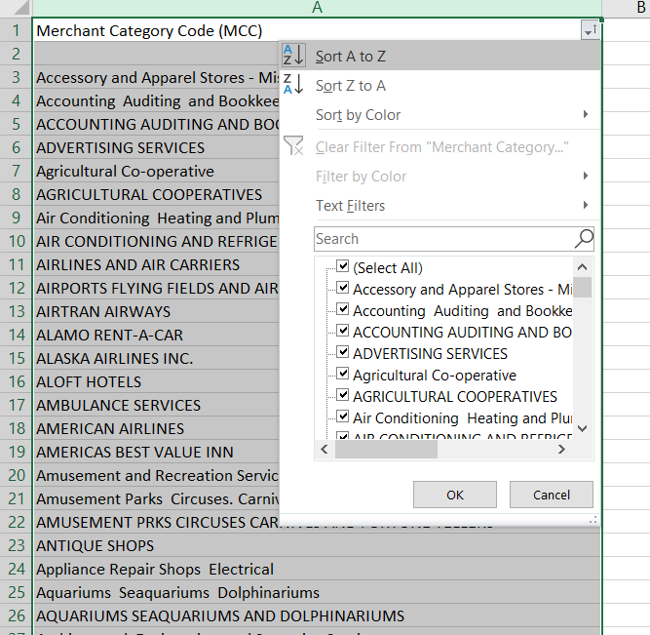
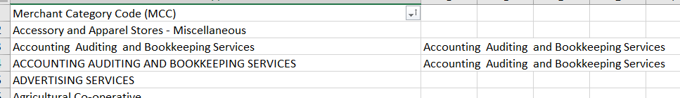
4. Get to work
Copy Merchant Category (MCC) column and paste into a separate tab
Highlight the column and click Remove Duplicates icon to remove duplicate entries
Filter the column and choose “Sort A to Z”
Group similar categories into one
Go back to the previous tab
Put the formula into the next blank column =VLOOKUP(J1154,Sheet1!A:B,2,0) to get the newly grouped category

Slide 11
Practice! Practice! Practice
Reperform these steps on OSU FY2011 P-Card.xlsx

